Slide 1
Relativistic Momentum

Slide 2
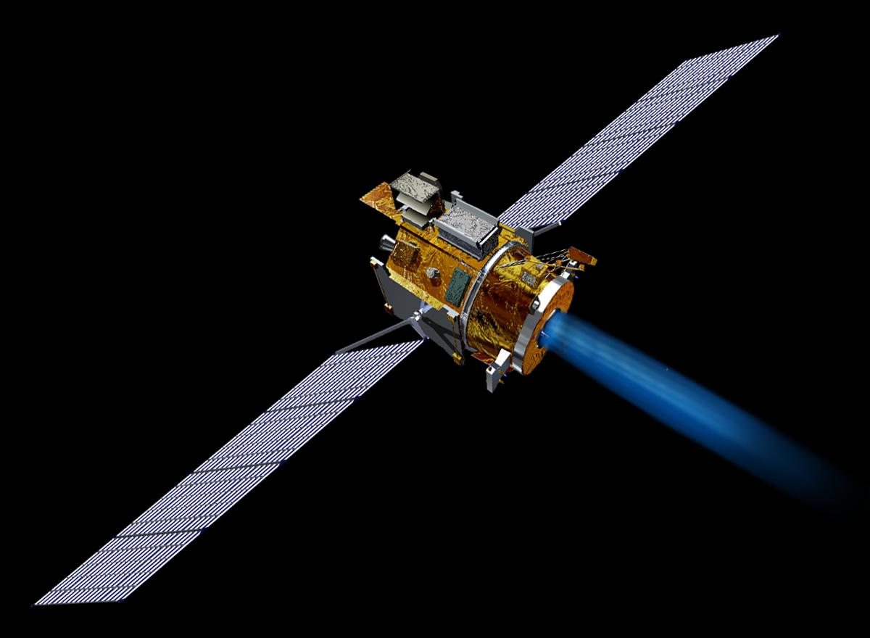
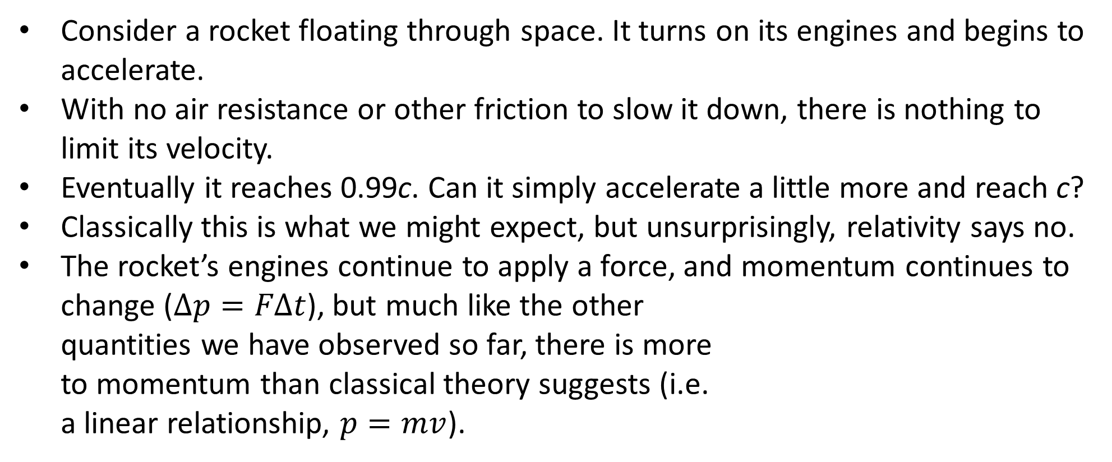
Accelerating at Relativistic Speeds
Consider a rocket floating through space. It turns on its engines and begins to accelerate.
With no air resistance or other friction to slow it down, there is nothing to limit its velocity.
Eventually it reaches 0.99c. Can it simply accelerate a little more and reach c?
Classically this is what we might expect, but unsurprisingly, relativity says no.
The rocket’s engines continue to apply a force, and momentum continues to change ($Δp=FΔt$), but much like the other quantities we have observed so far, there is more to momentum than classical theory suggests (i.e. a linear relationship, $p=mv$).

Slide 3
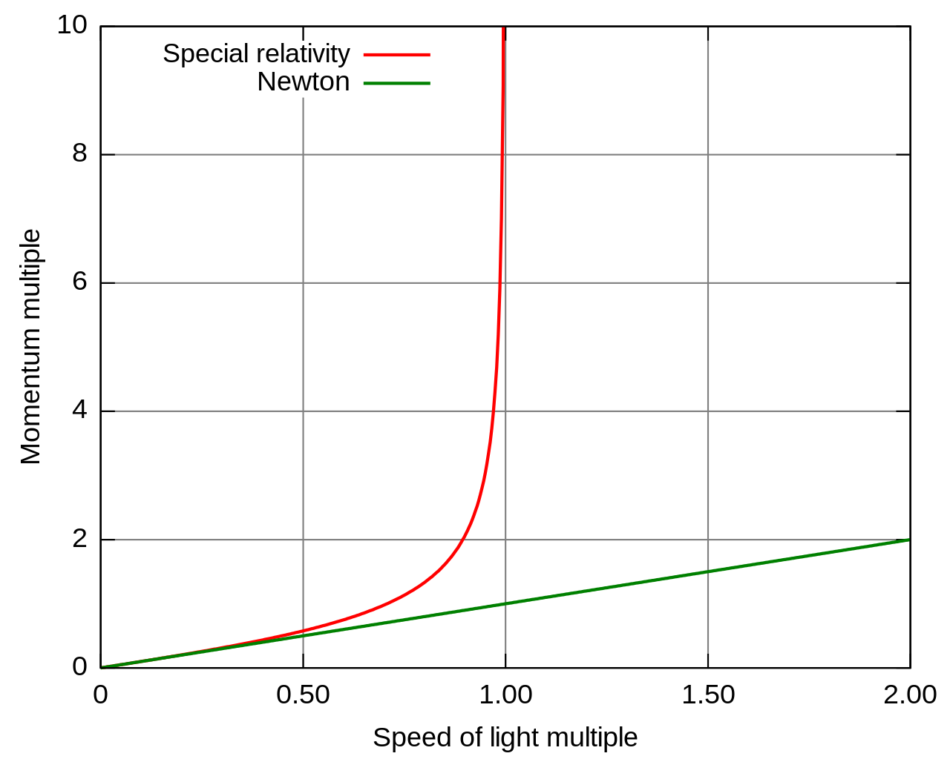
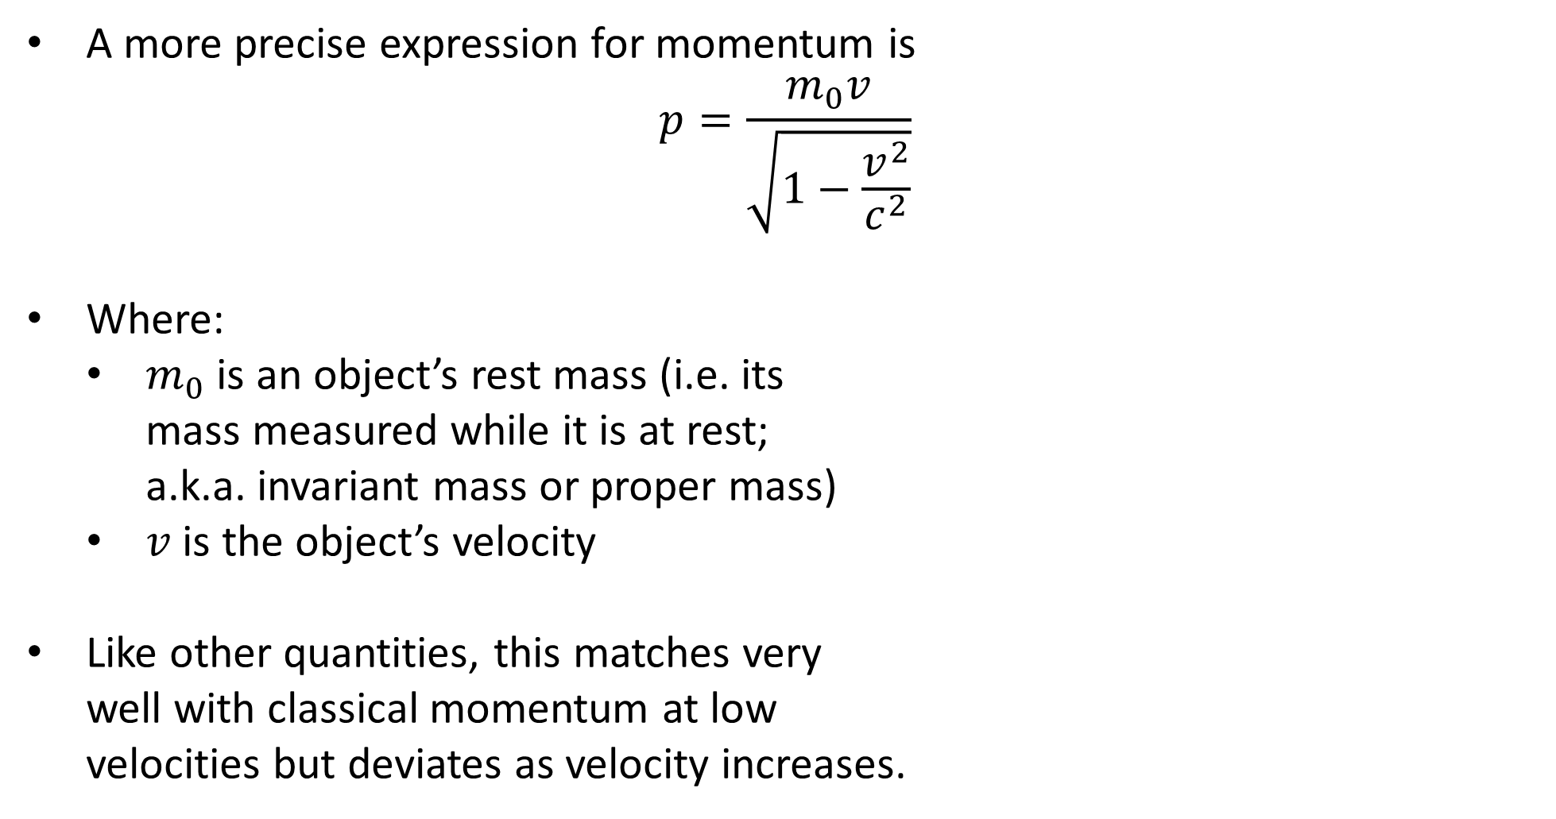
Relativistic Momentum
A more precise expression for momentum is
$$p=\frac{m_{0}v}{\sqrt{1−\frac{v^{2}}{c^{2}}}}$$
Where:
$m_{0}$ is an object’s rest mass (i.e. its mass measured while it is at rest; a.k.a. invariant mass or proper mass)
$v$ is the object’s velocity
Like other quantities, this matches very well with classical momentum at low velocities but deviates as velocity increases.

Slide 4
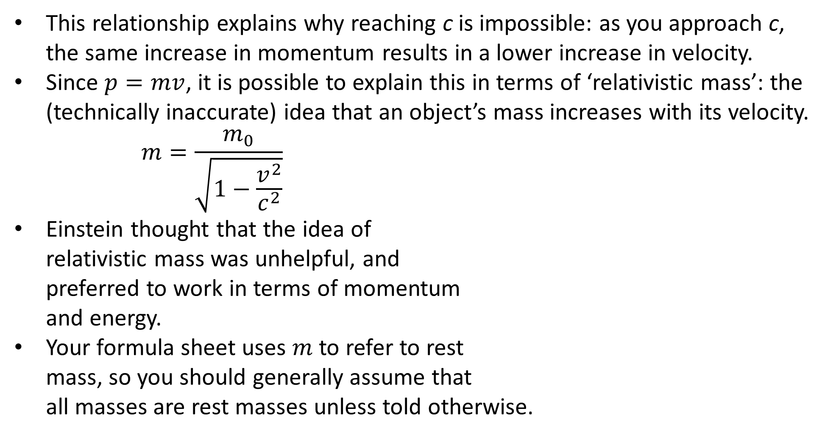
Relativistic Mass?
This relationship explains why reaching c is impossible: as you approach c, the same increase in momentum results in a lower increase in velocity.
Since $p=mv$, it is possible to explain this in terms of ‘relativistic mass’: the (technically inaccurate) idea that an object’s mass increases with its velocity.
$$m=\frac{m_{0}}{\sqrt{1−\frac{v^{2}}{c^{2}}}}$$
Einstein thought that the idea of relativistic mass was unhelpful, and preferred to work in terms of momentum and energy.
Your formula sheet uses $m$ to refer to rest mass, so you should generally assume that all masses are rest masses unless told otherwise.
Notes:
Okay so the actual reason is quite a bit more complicated, but this definitely helps!
Note that just like length contraction doesn’t mean that an object is being compressed, relativistic mass doesn’t mean that an object’s particles are multiplying or somehow getting bigger / heavier.

Slide 5
Example #1
Compare the classical and relativistic momentum of an electron moving at 0.99c.

Slide 6
Example #2
In the Large Hadron Collider, protons are accelerated in a ring and reach a top speed of 99.99991% of the speed of light. What is their relativistic momentum at this speed, and how does it compare to their classical momentum?
Notes:
3.74 × 10⁻¹⁶ N s
5.02 × 10⁻¹⁹ N s: 745 times less!

